Slide 1
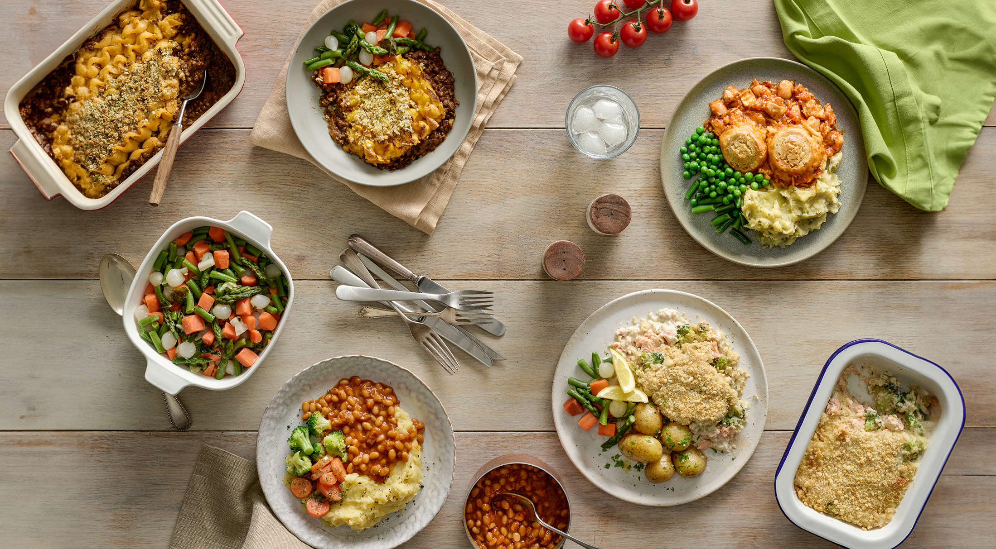

Mission Nutrition:
Cooking Up Healthy Habits
Enter Date Here

Slide 2
Lesson Breakdown
1.
2.
3.
Food Frequency
& Key Messages
Preparation
of Dish
Plenary

Slide 3



Lesson Objectives
… children will be able to make a vegetable quiche
… children will be able to explain why certain foods are needed
… children will be able to understand and describe food traffic lights

Slide 4
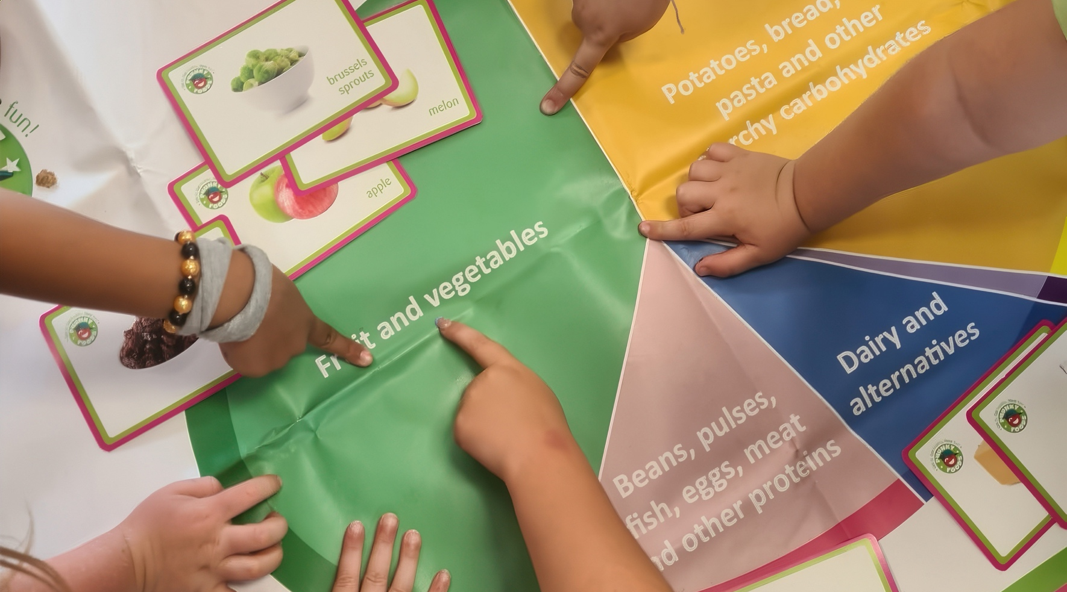

Starter

Slide 5
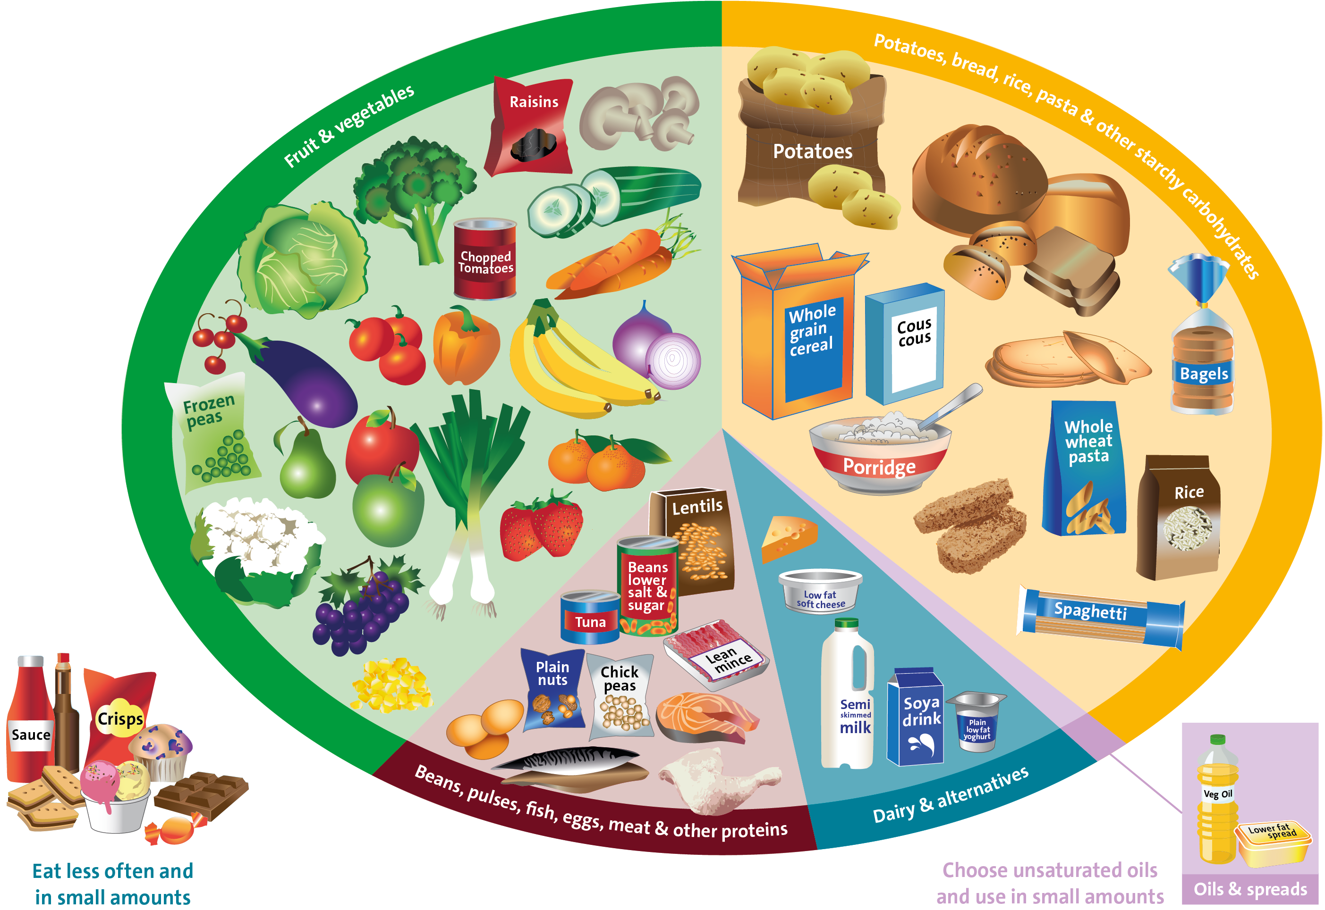
What is the Eatwell Guide?
Source: Public Health England in association with the Welsh Government, Food Standards Scotland and the Food Standards Agency in Northern Ireland

Slide 6





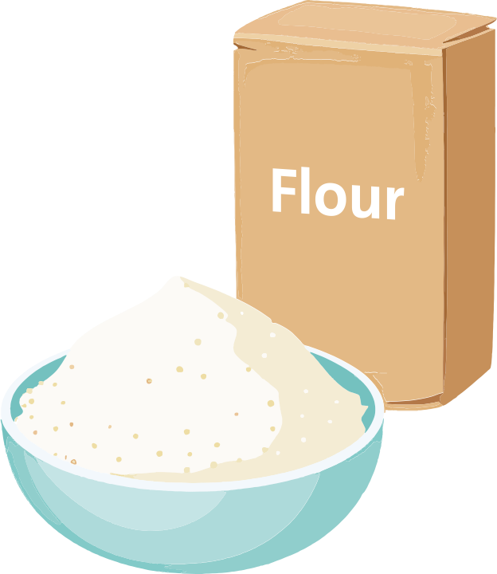
Where do your ingredients go?
Notes:
Answer order:
1. Red Pepper,
2. Onion
3. Cheese
4. Eggs
5. Oil
6. Flour

Slide 7
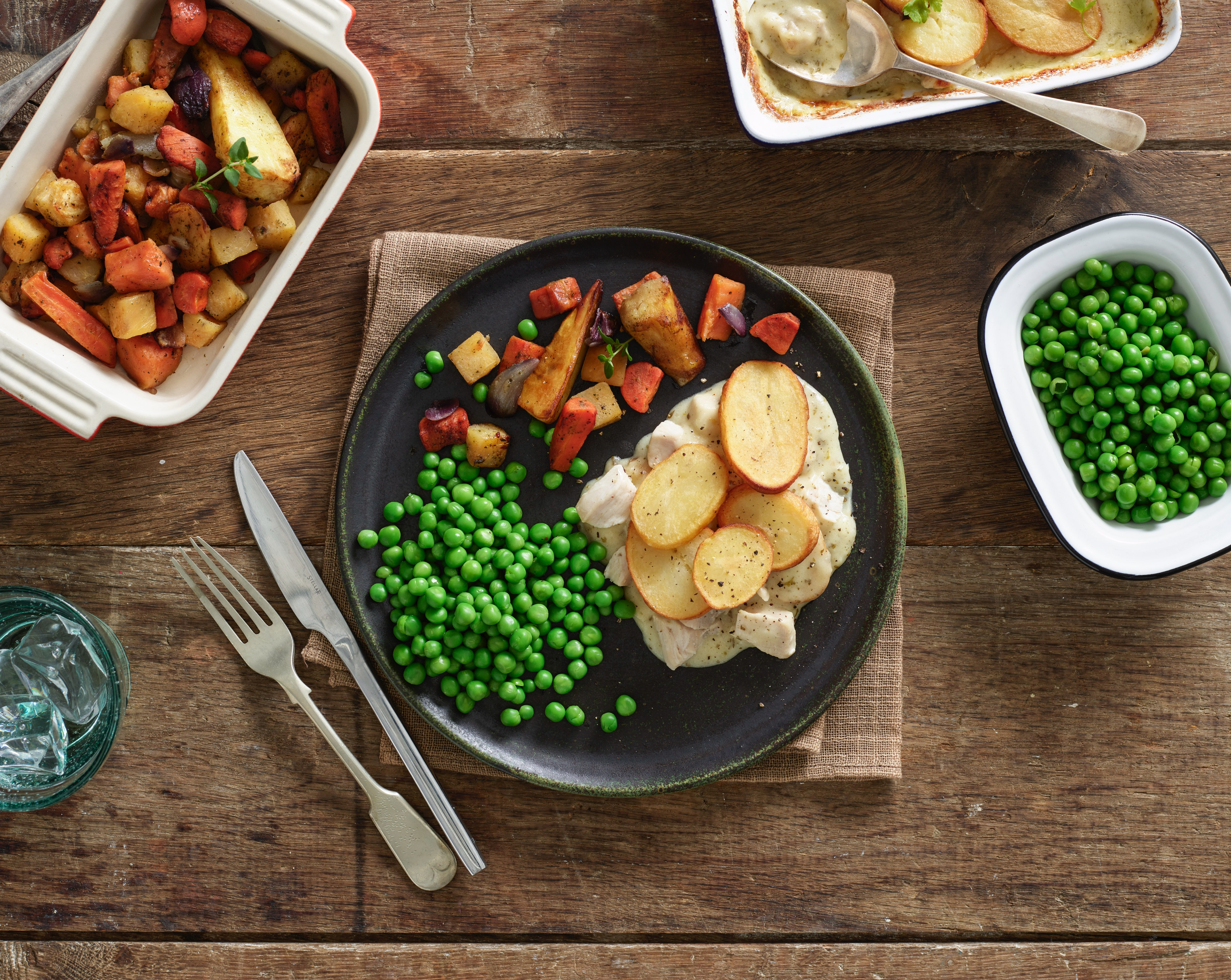
Food Frequency Messages

Slide 8
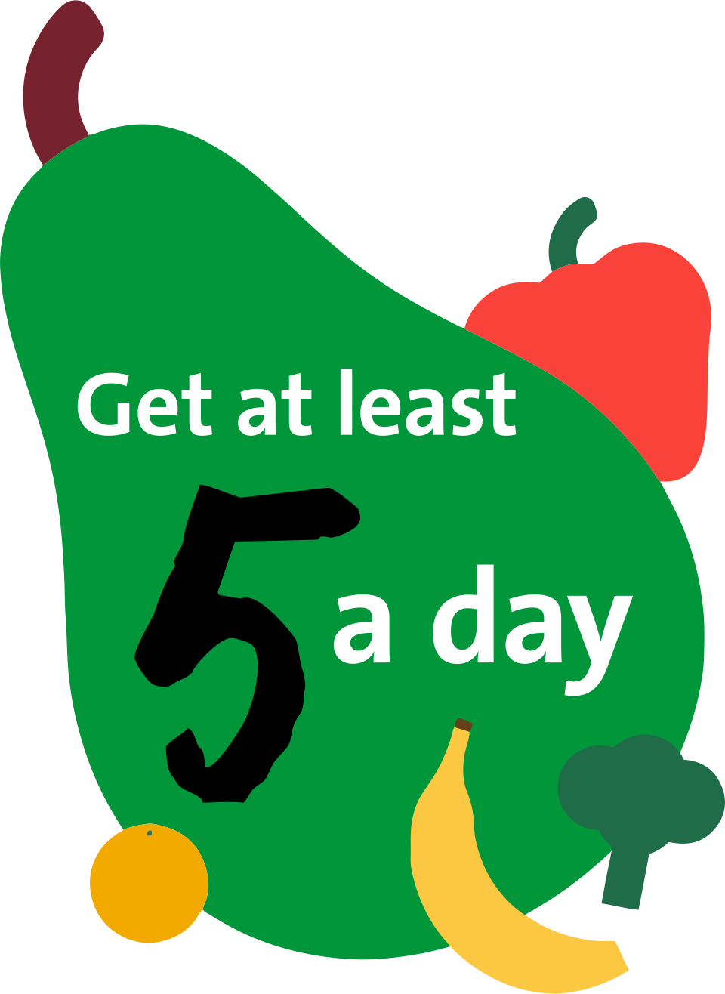


5-a-Day
How big is a portion?
True or False?
“Fruit juice counts towards one of your 5 a day”
Pineapple
True – but only unsweetened 100% fruit juice, vegetable juice and smoothies – maximum 150ml, once a day
Fresh
Tinned
Juice
Dried
Frozen
Notes:
Content vs activity- make the activity visible and exciting throughout- different colour box, description of the activity.
Ideally three vegetable and two fruit portions a day at 40g
If you don’t like a boiled carrot, have you tried a roasted or a raw carrot?
Eat a rainbow (get children to name fruit or vegetables that belong to the main colours of the rainbow; yellow, orange, red, green, blue, purple)

Slide 9

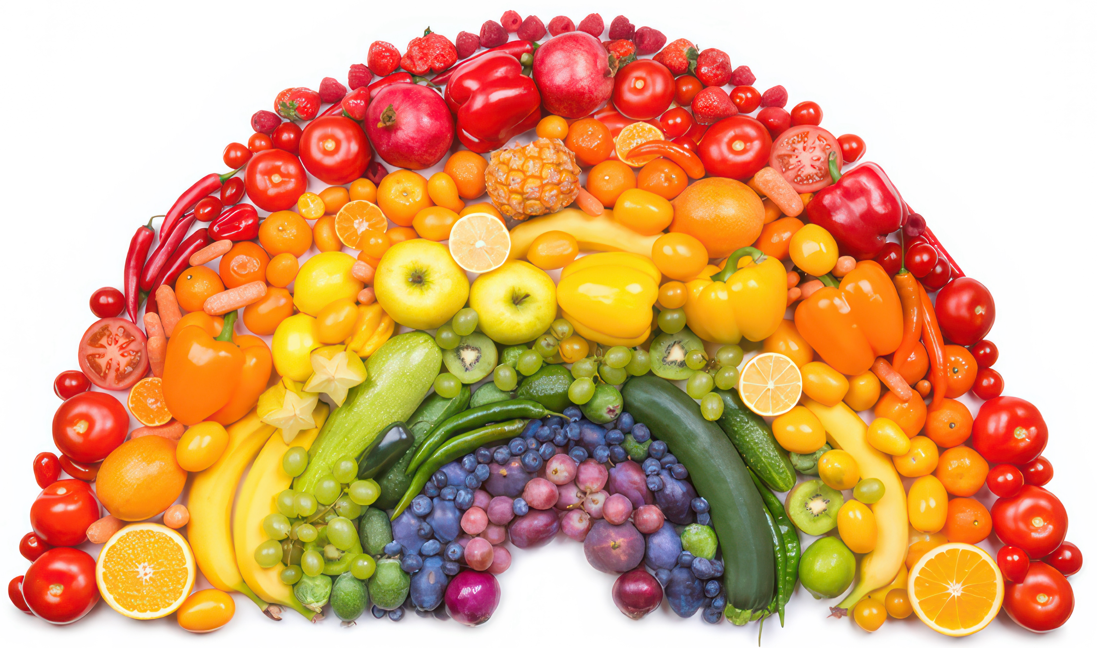

5-a-Day
Can you name any fruits or vegetables that match the colours of the rainbow?
Notes:
Content vs activity- make the activity visible and exciting throughout- different colour box, description of the activity.
Ideally three vegetable and two fruit portions a day at 40g
If you don’t like a boiled carrot, have you tried a roasted or a raw carrot?
Eat a rainbow (get children to name fruit or vegetables that belong to the main colours of the rainbow; yellow, orange, red, green, blue, purple)

Slide 10



Calcium
What is calcium needed for in our body?
Where are these on our Eatwell Guide?
How can we fit these into our meals?

Slide 11
Saturated Fats
Where does this sit on the plate?
Notes:
Saturated vs unsaturated
Where does a nut go?
Where does rapeseed oil?
Where does butter go?
Where does cheese go?

Slide 12





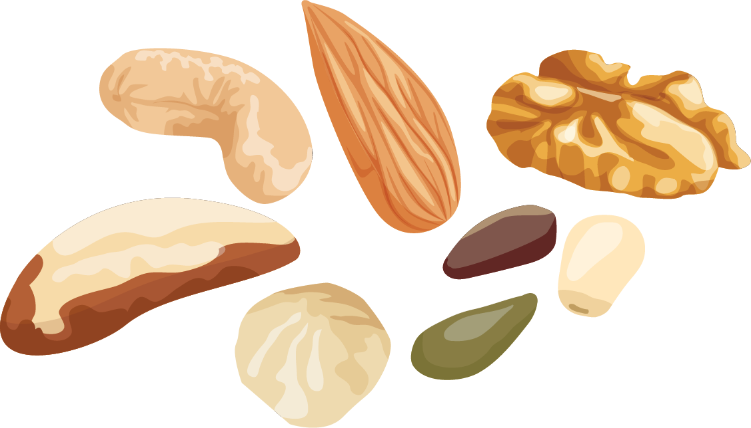

Saturated Fats
There are two types of fats:
Saturated
Unsaturated
Notes:
Saturated vs unsaturated
Where does a nut go?
Where does rapeseed oil?
Where does butter go?
Where does cheese go?

Slide 13

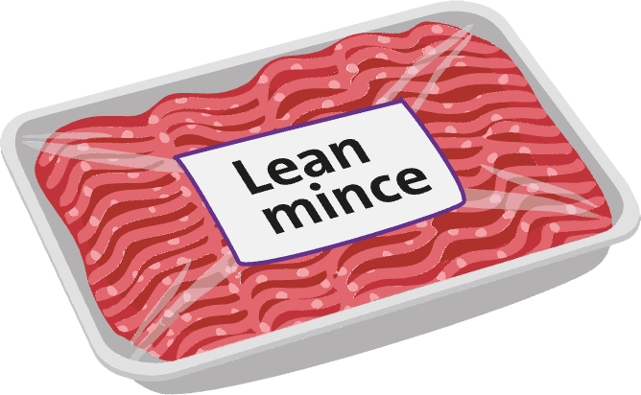

Saturated Fats
Swap fats in meals
Notes:
Saturated vs unsaturated
Where does a nut go?
Where does rapeseed oil?
Where does butter go?
Where does cheese go?

Slide 14
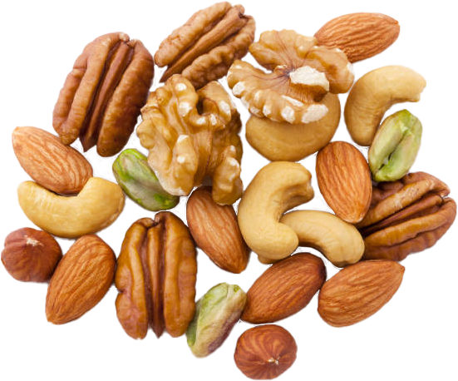


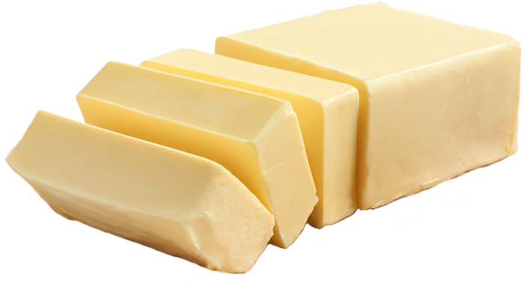
Saturated Fats
Swap fats in meals
Saturated Fat
or
Unsaturated Fat
Notes:
Saturated vs unsaturated
Where does a nut go?
Where does rapeseed oil?
Where does butter go?
Where does cheese go?

Slide 15
Saturated Fats
Swap fats in meals
Saturated Fat
or
Unsaturated Fat
Notes:
Saturated vs unsaturated
Where does a nut go?
Where does rapeseed oil?
Where does butter go?
Where does cheese go?

Slide 16


Sugar
Natural sugar
vs
Unnatural sugar
Natural sugars found in fruit are better for you than added unnatural sugars

Slide 17


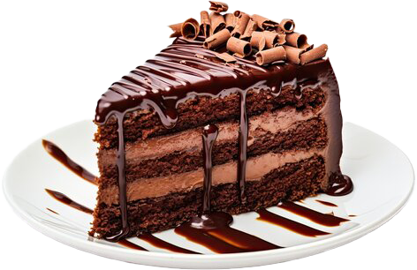




Sugar
Ways to reduce sugar
Which one is the odd one out?
Choose water over fizzy drinks to keep hydrated
Snack on fruit and vegetables instead of sweets
Unnatural sugar

Slide 18
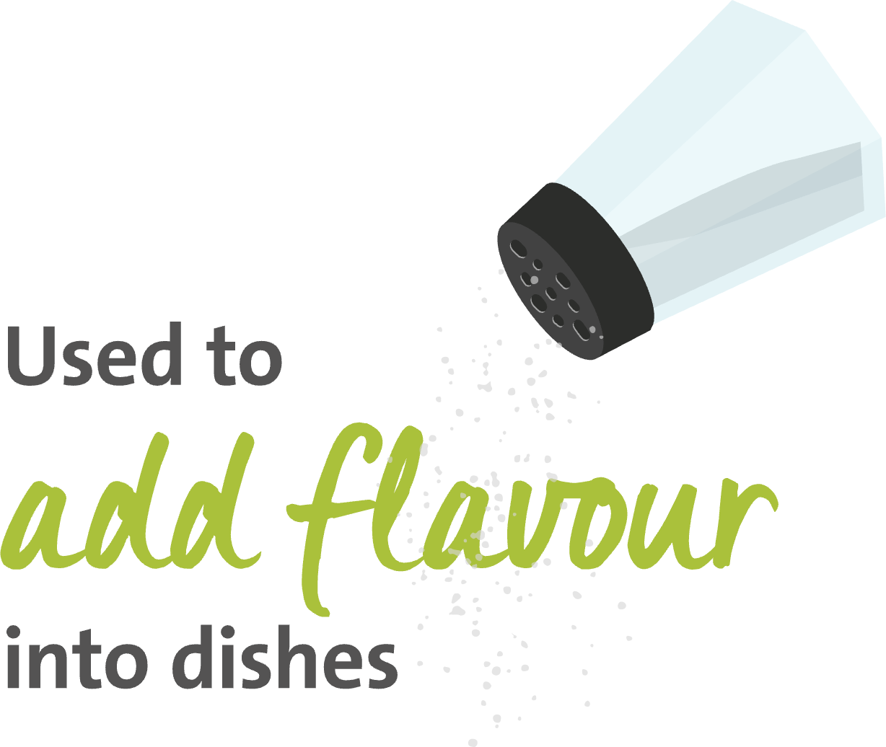



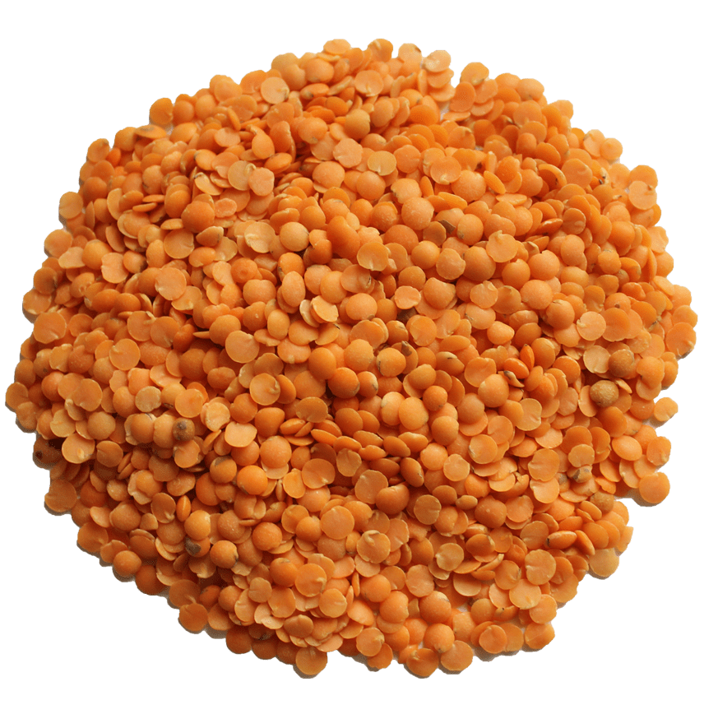
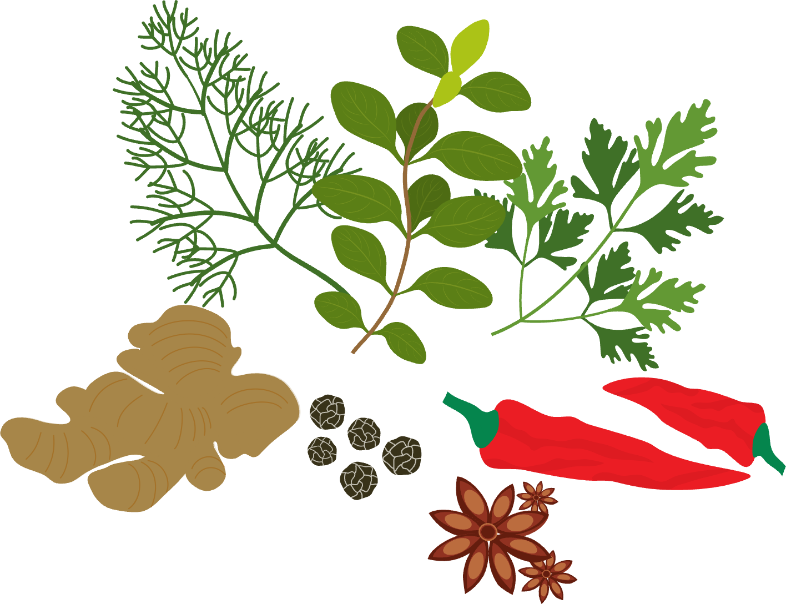




Salt
Which food contains the most salt?
Ways to reduce salt intake:
Use herbs or spices to add flavour
Swap salty snacks like crisps to alternatives such as vegetable sticks or fruit
Choose reduced salt versions of your favourite foods – crisps, sauces, ready meals, processed/cured meats

Slide 19
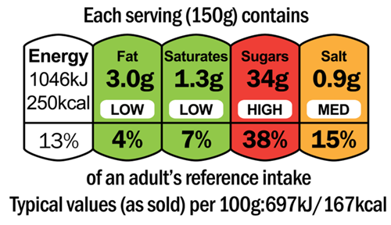

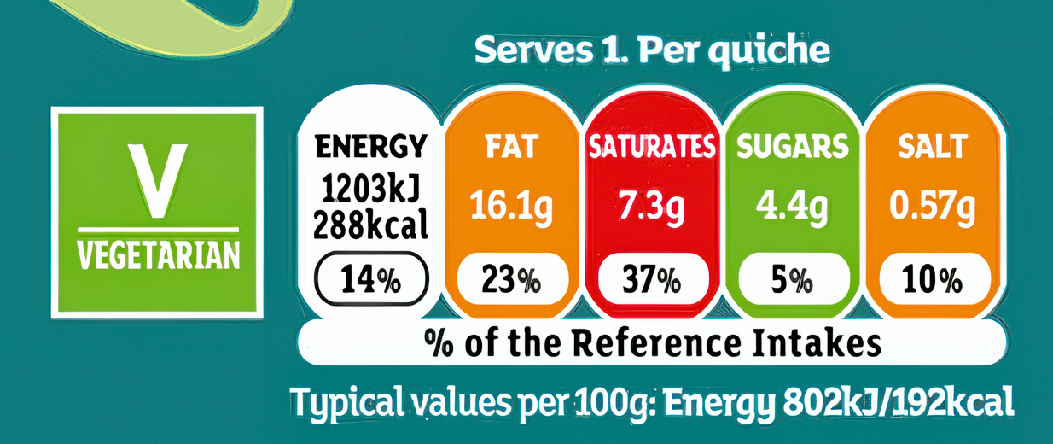
Traffic Lights
What are traffic lights and what do they mean?

Slide 20
What Do The Colours Mean?
High – eat less often and smaller amounts
Red
Medium – eat in moderation
Amber
Low – eat more often and larger amounts
Green
Notes:
Activity- pair the description with the colour- animated ping them across
Go

Slide 21




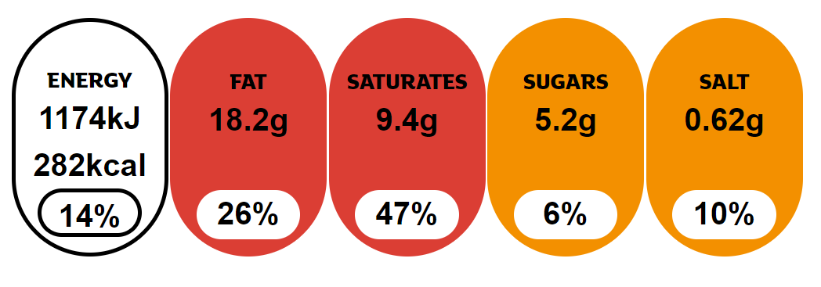
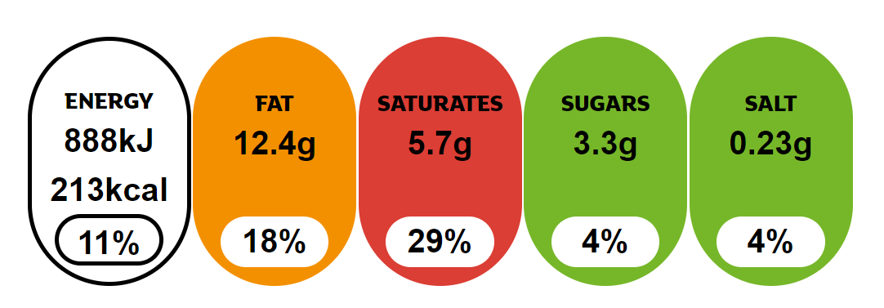
Which one would you pick?
OR
Notes:
Blank out Sainsburys & taste the difference so it’s unbranded

Slide 22
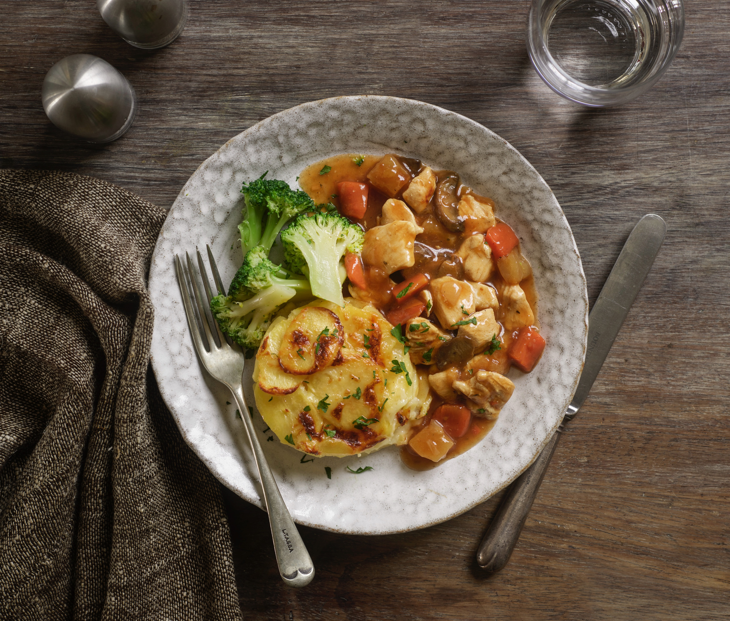
Quiche Preparation
Notes:
Teacher Note: Before you begin the lesson, please remember to ask children to wash their hands, put on any aprons is necessary and show them how to handle any equipment safely.

Slide 23
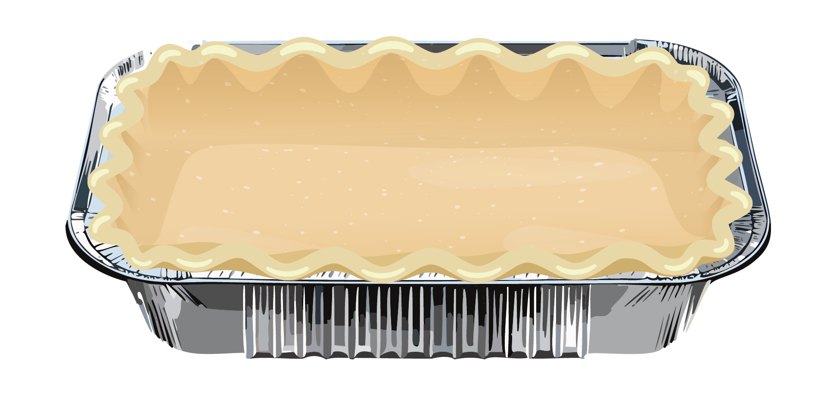
Our Quiche Ingredients
Eggs
Cheese
Red Pepper
Onion
Pastry
Notes:
Teacher Note: Use the demo table to make a quiche first, before the children go off to do it in groups.

Slide 24


Step 1: Unroll the pastry
Dust the worktop with the flour
Unroll the pastry sheet onto the flour-dusted worktop

Slide 25

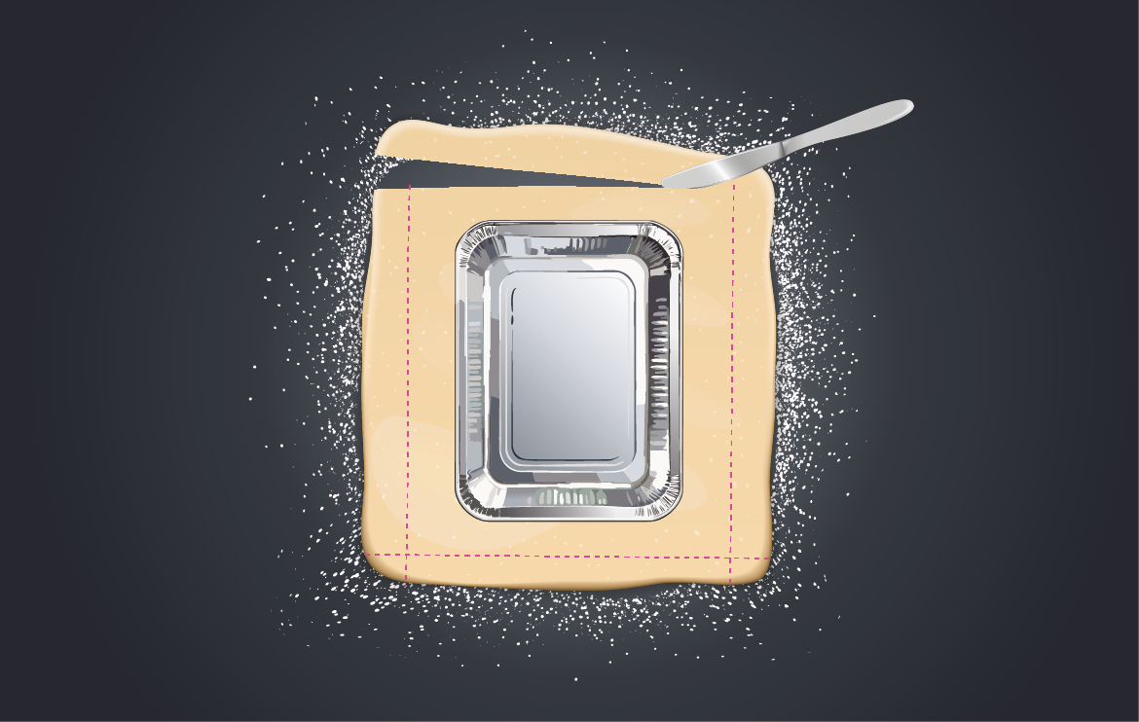
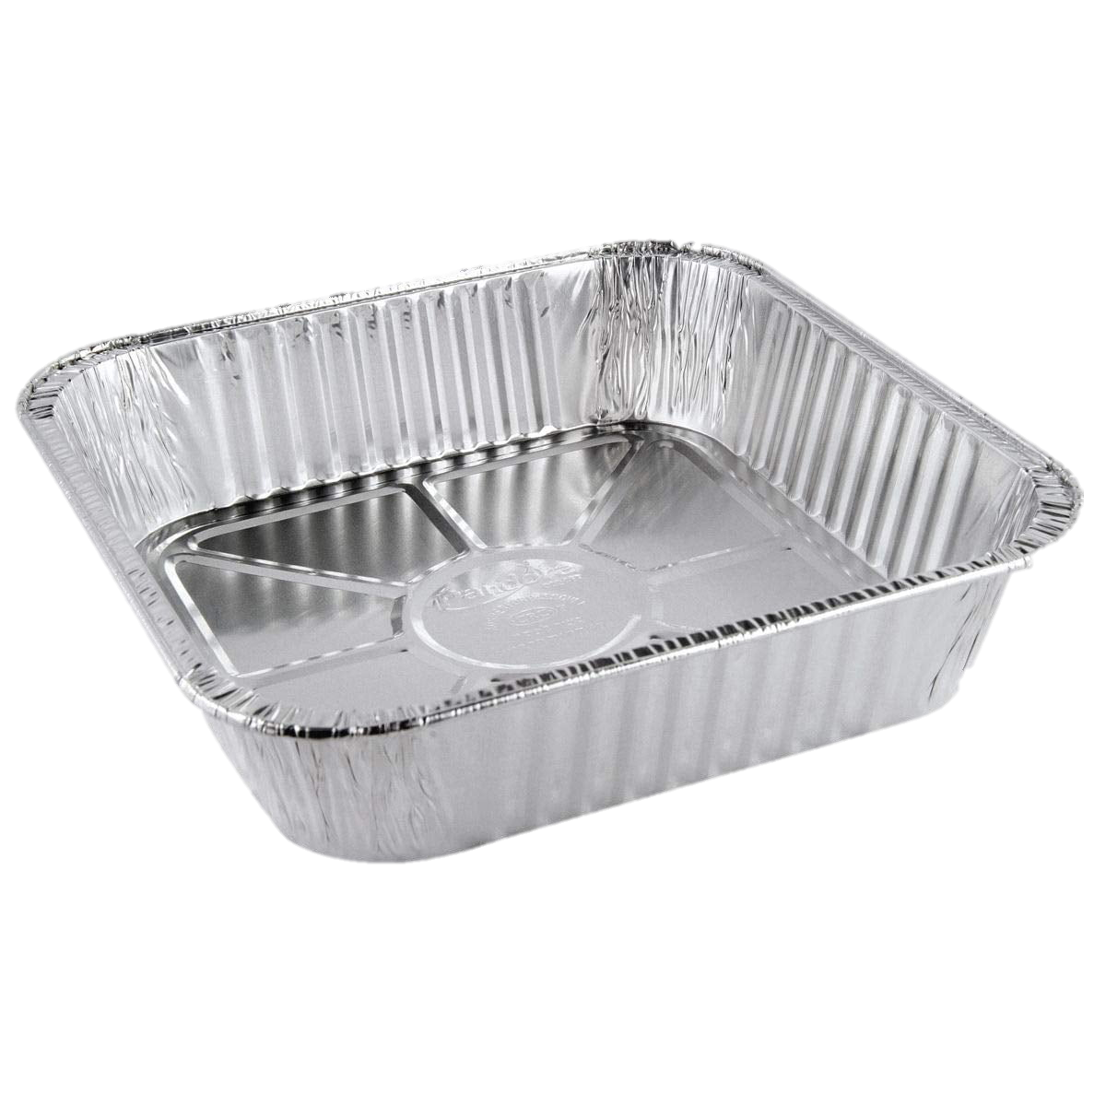
Step 2: Cutting pastry
Place the foil dish over the pastry
Carefully use the knife to cut the pastry, leaving enough to cover the sides of the dish as well as the bottom

Slide 26

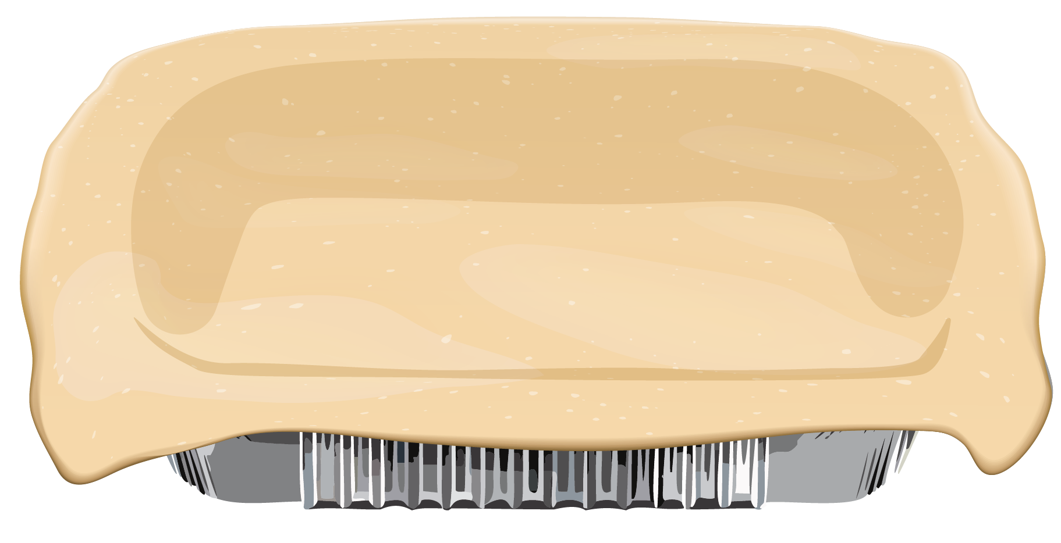
Step 3: Placing pastry
Roll the pastry around the rolling pin, then unroll it on top of the foil dish
Push the pastry down into the dish, patting it up the sides too
Carefully trim any excess pastry off using the knife

Slide 27


Step 4: Eggs
Crack 4 eggs into the jug
Use the whisk to mix them together

Slide 28
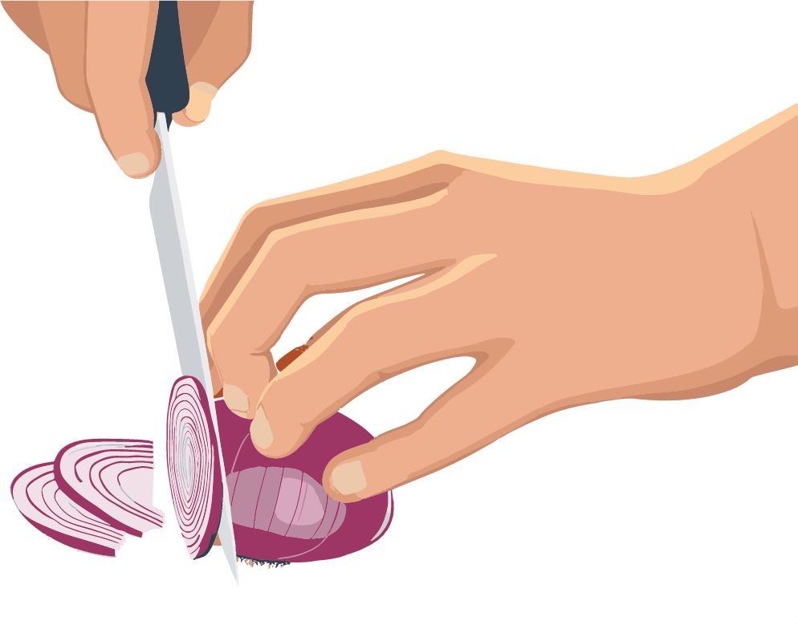
Step 5: Preparation of filling
If you would like smaller vegetables, carefully chop them using the claw knife grip
Add them to the whisked eggs

Slide 29
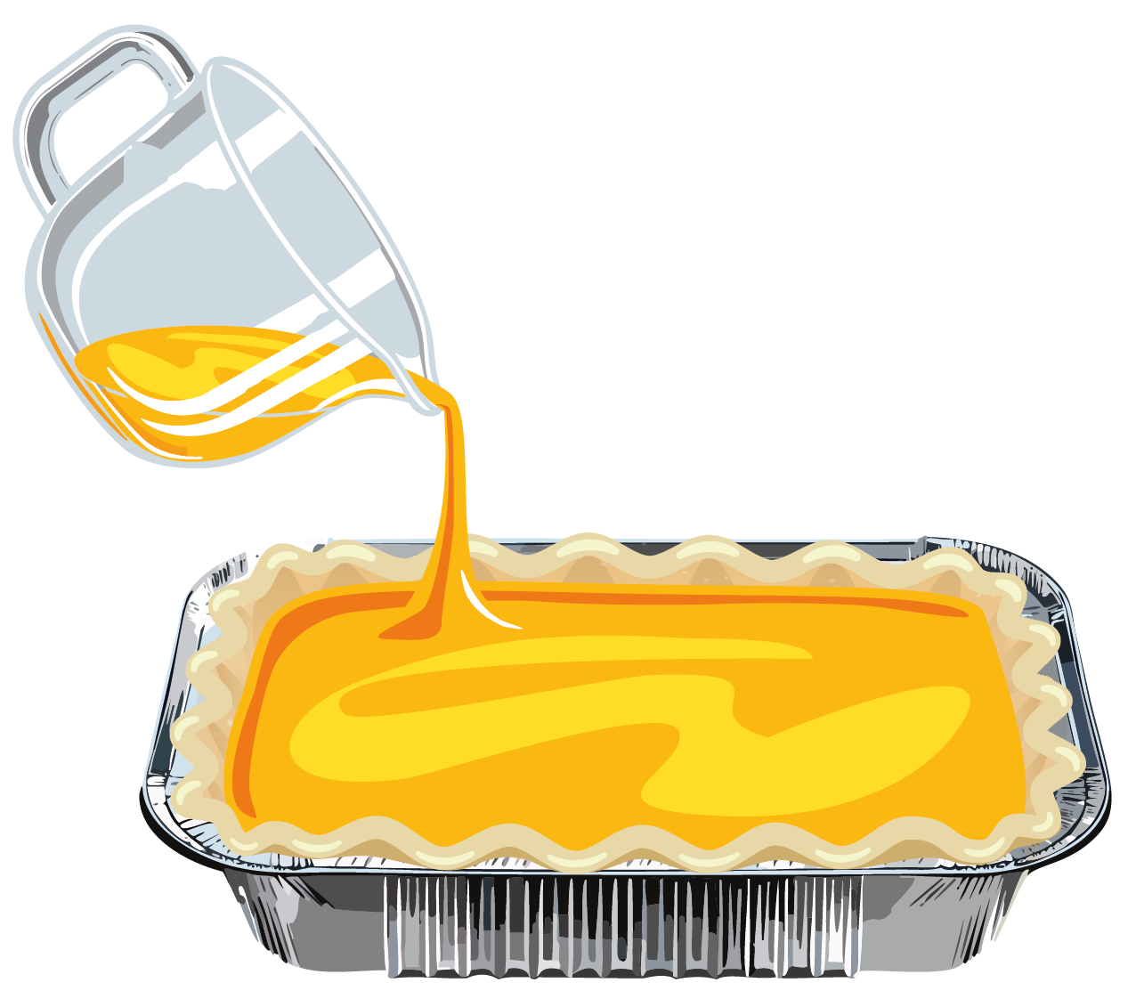
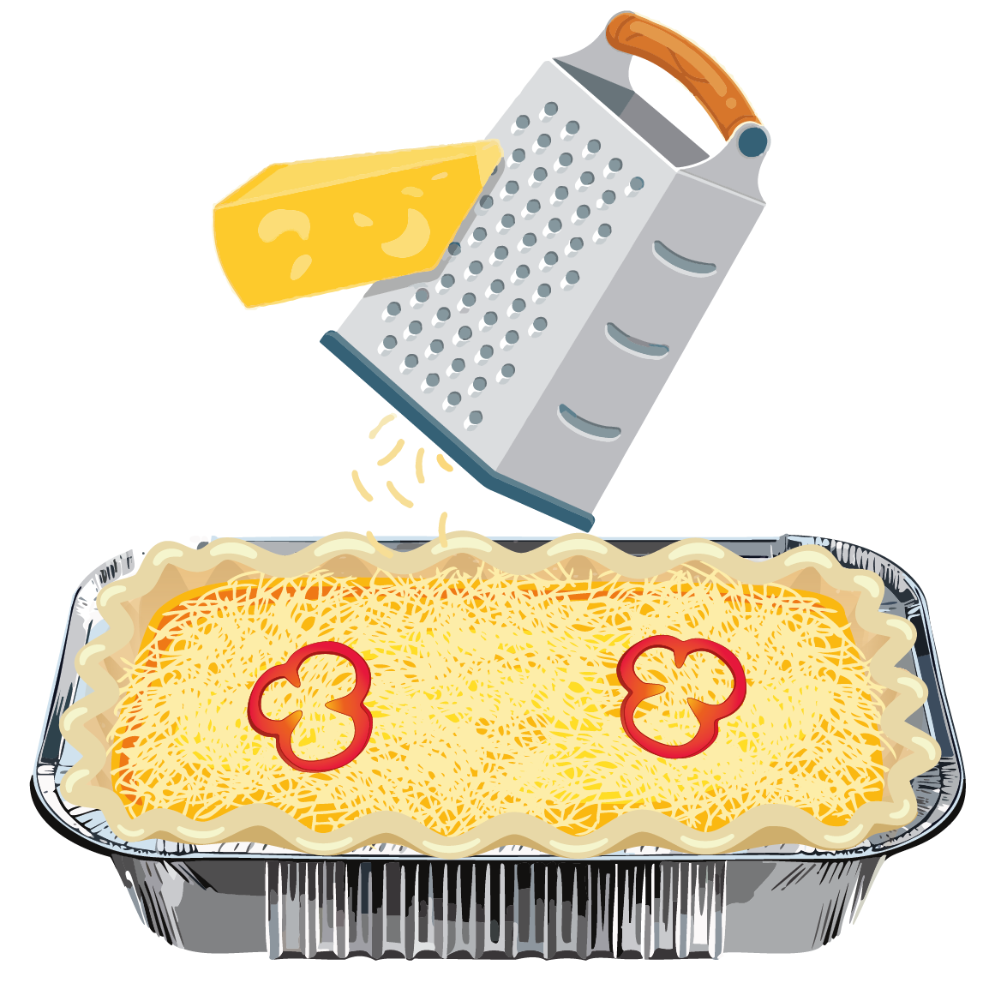
Step 6: Putting it all together
Decorate with extra vegetables or cheese if you would like
Pour filling mixture into the pastry case

Slide 30

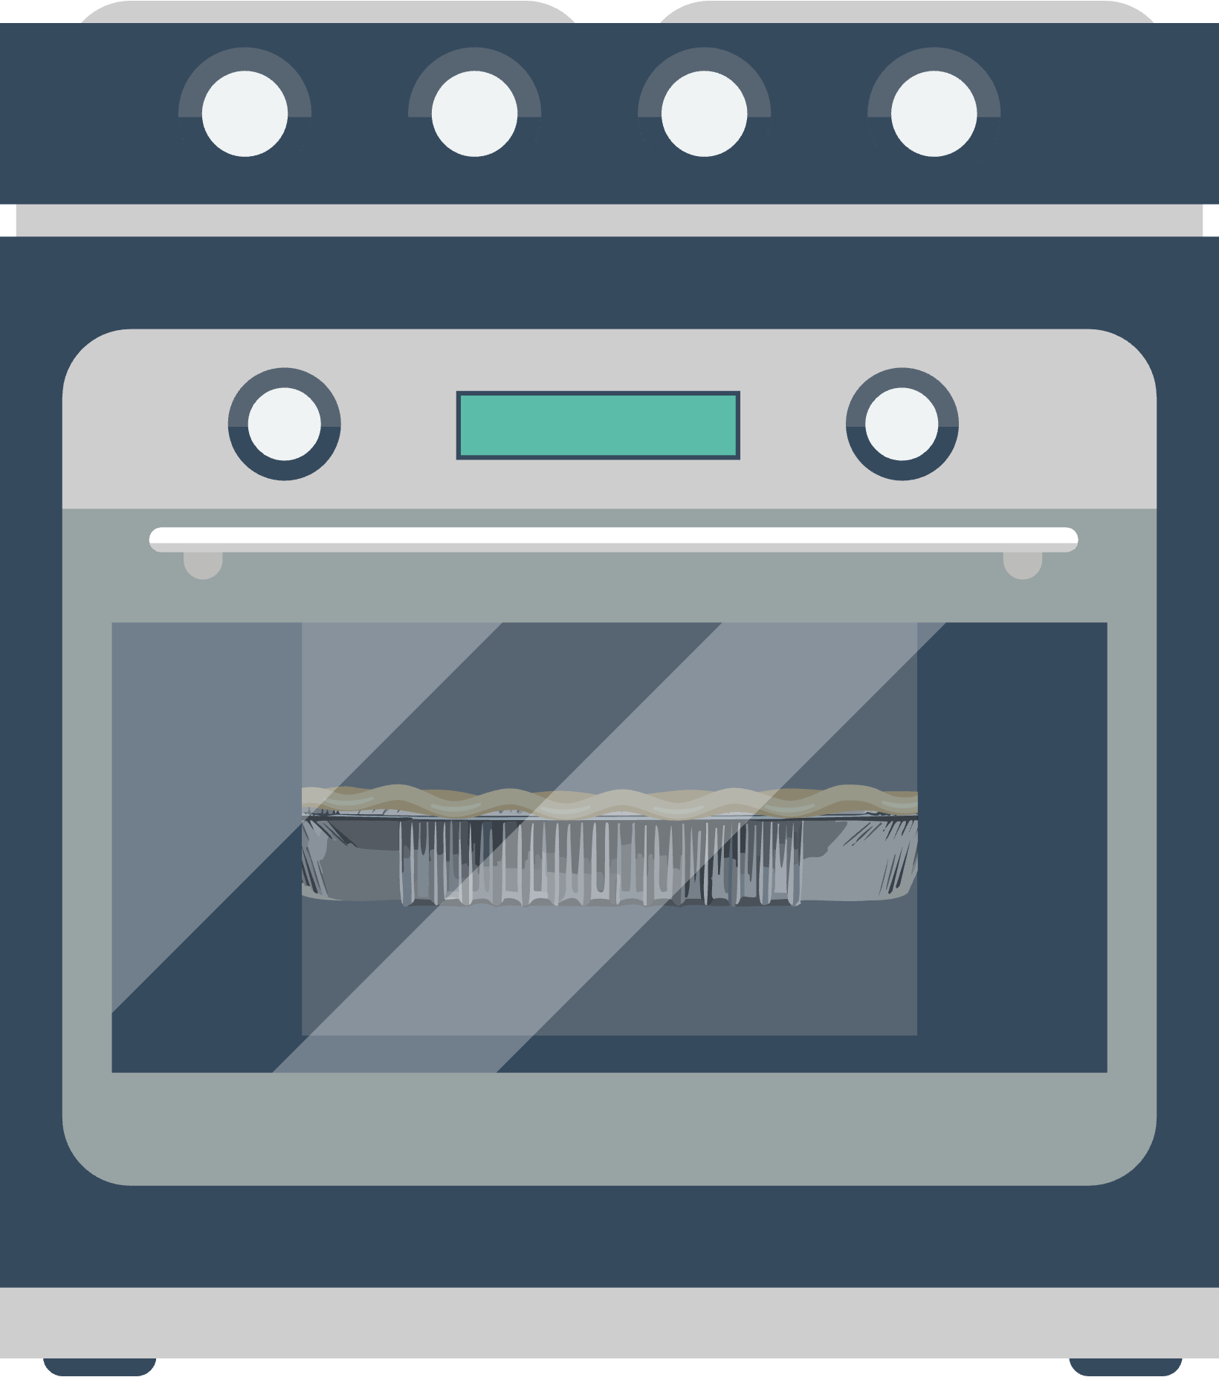
Step 7: Cooking
Teachers will cook in ovens
Take home and enjoy!

Slide 31
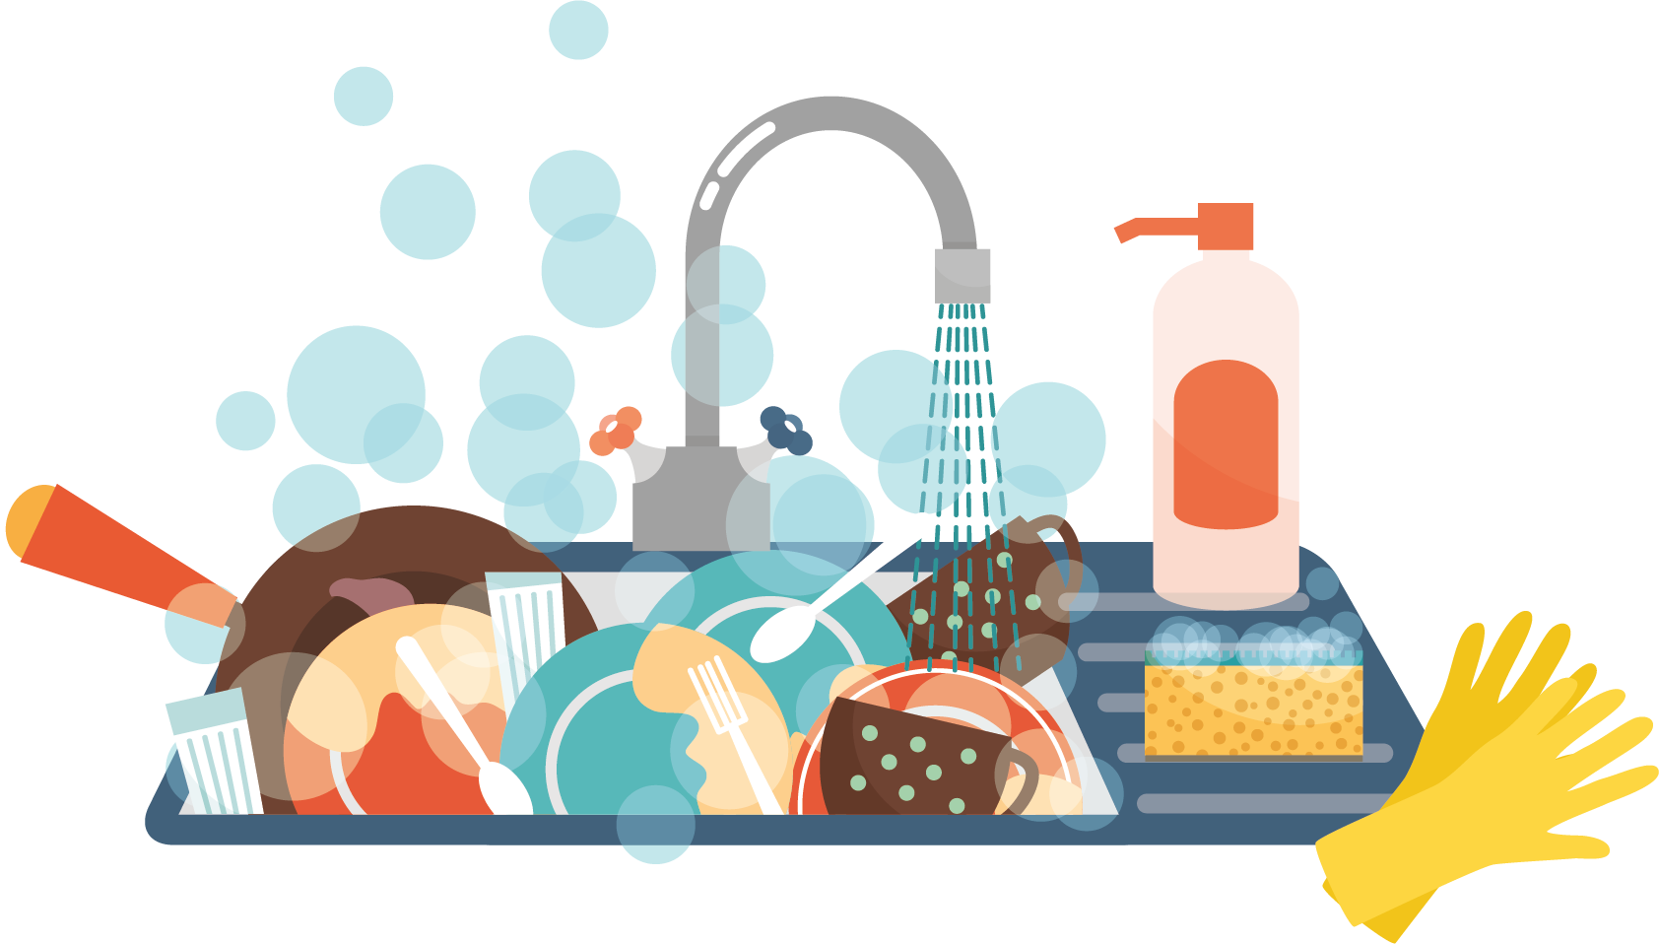
Step 8: Tidying up
Carefully put all your used equipment in a neat pile ready for washing up

Slide 32

Plenary

Slide 33

Plenary
… children will be able to make a vegetable quiche
… children will be able to explain why certain foods are needed
… children will be able to understand and describe food traffic lights

Slide 34
Thank You

